Slide 1
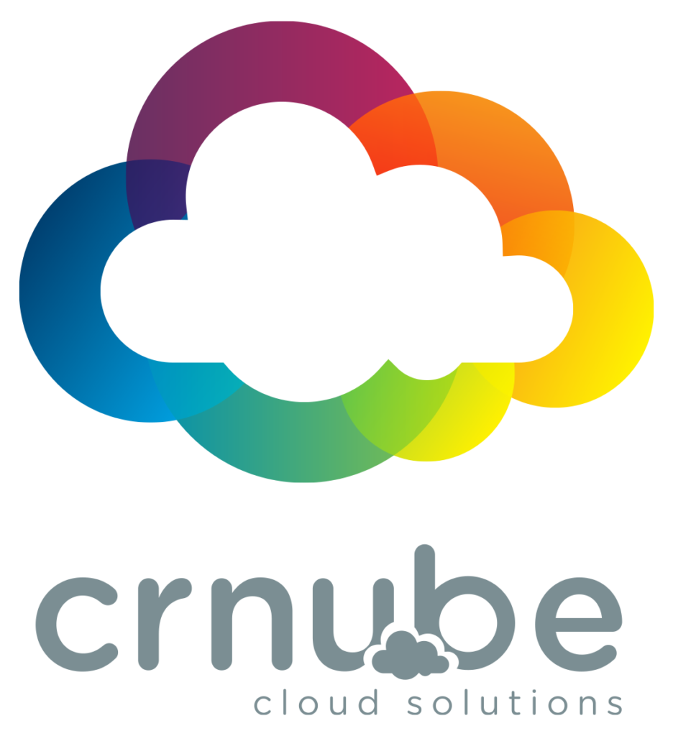
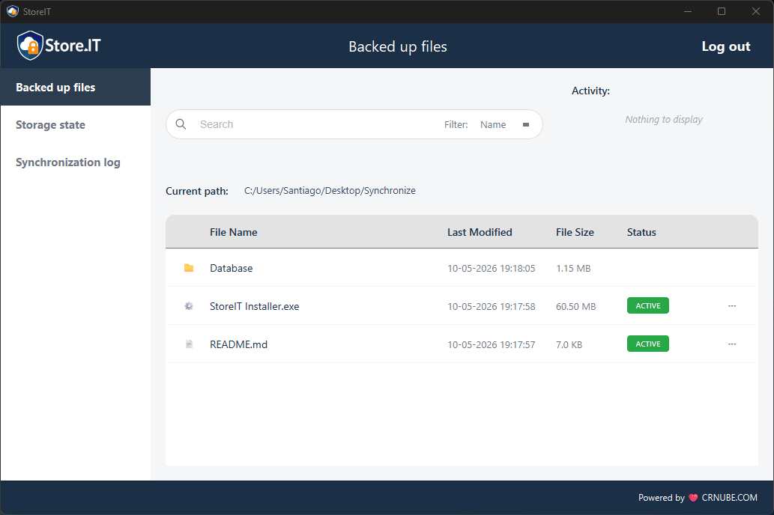
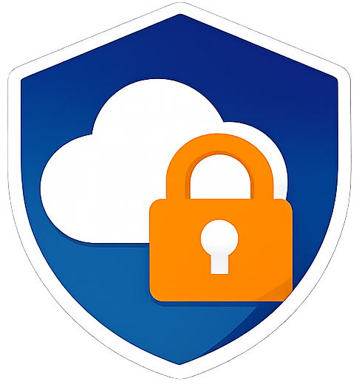
Synchronization from
Client to Server Manual

Slide 2
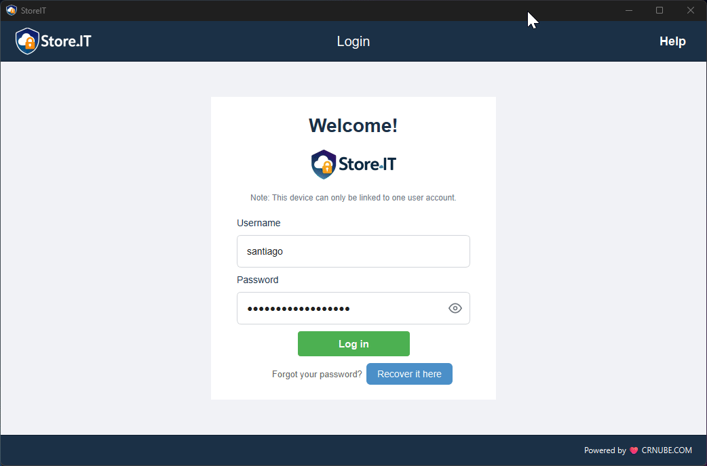
Selecting a folder
After your first login to the desktop application, you will be prompted to select the folder you wish to back up. Once selected, an initial synchronization of the files within it will be performed.

Slide 3
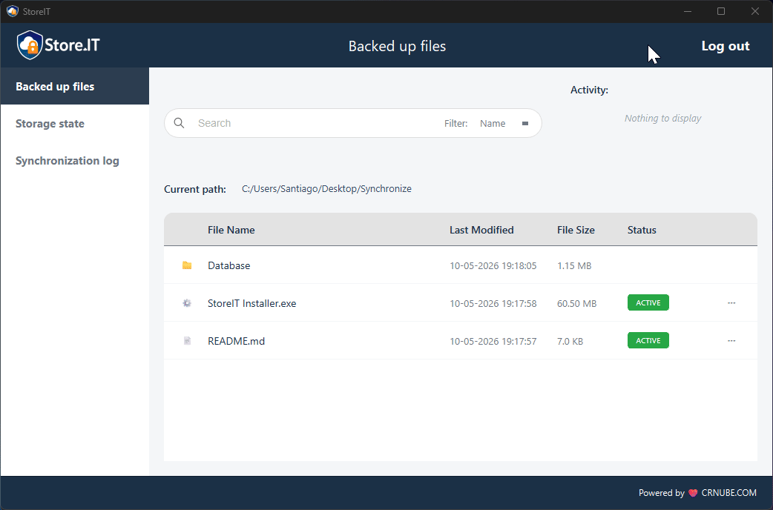
Creating a file
Once you are logged in and have selected the folder, you can create files within the folder and you will see them appear in both the desktop application interface and the web app, meaning that the file synchronization was successful.

Slide 4
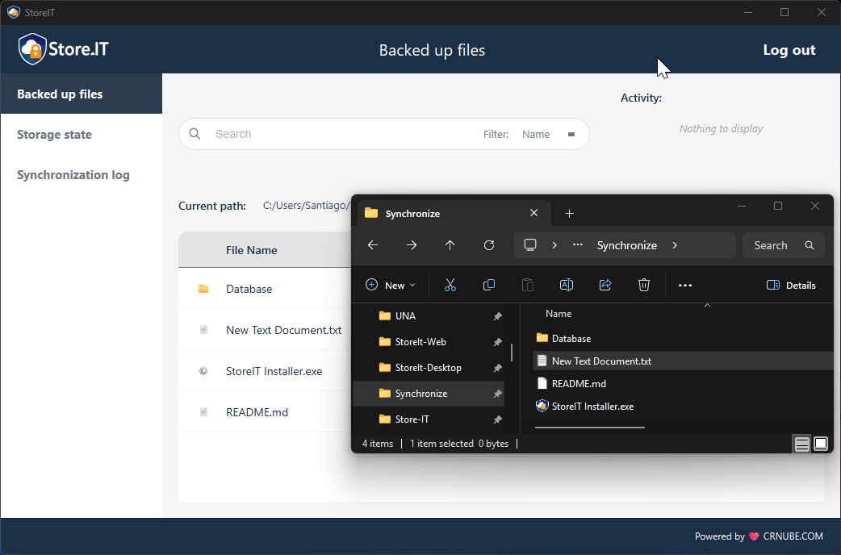
Renaming a file
Renaming a file also triggers a synchronization

Slide 5
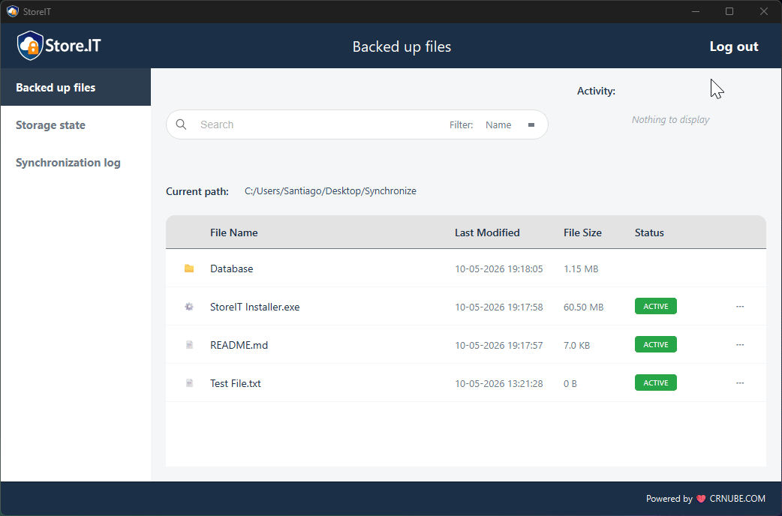
Modifying a file
Modifying a file also causes it to synchronize as soon as the changes are saved.

Slide 6
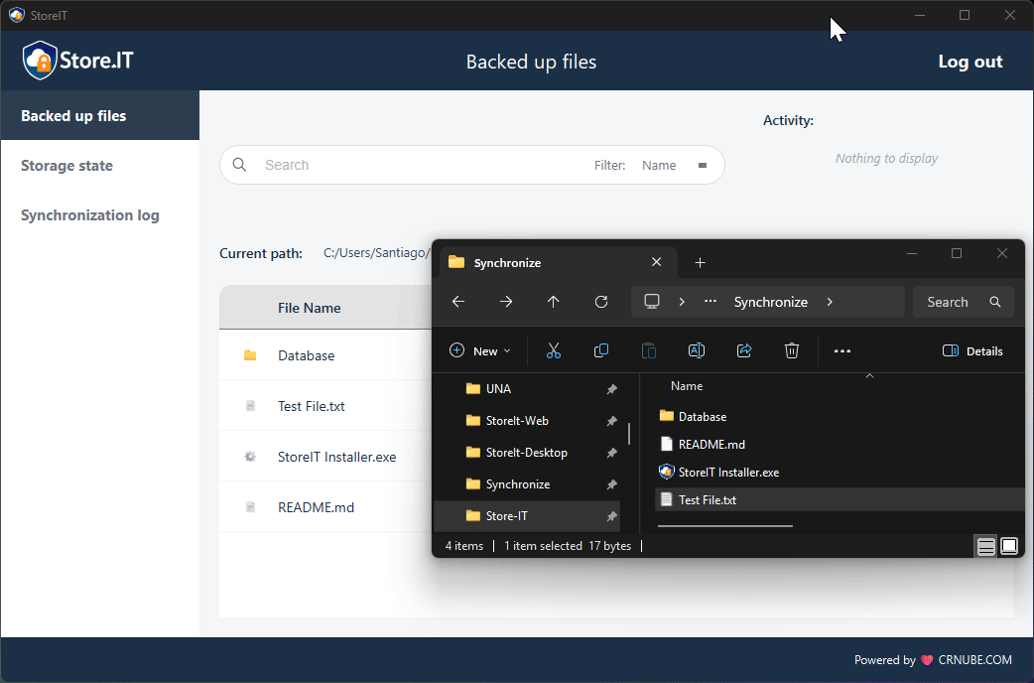
Moving a file
Moving a file also causes it to synchronize. This can be verified by browsing through folders in both the desktop and web applications.

Slide 7
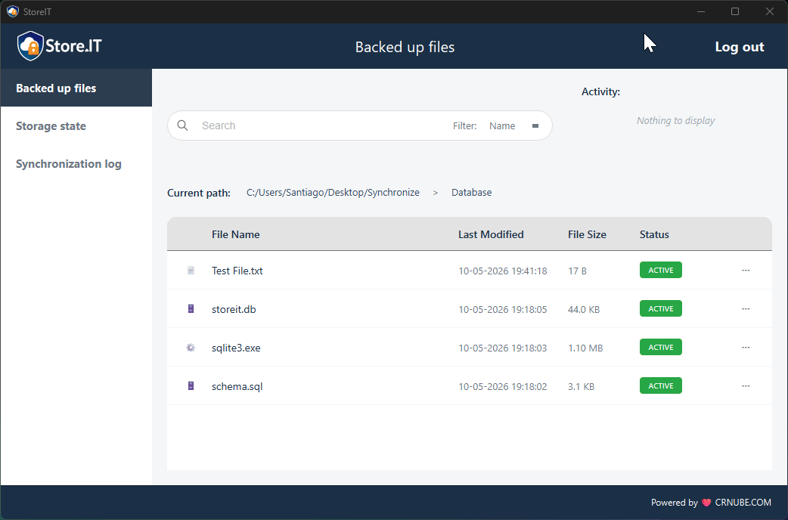
Deleting a file
Finally, deleting a backed-up file also deletes it from the web application.

Slide 8

Exploring features
Once your files are synchronized, there's a lot you can do: pause file sync to change it without synchronizing it, check your storage status, view sync logs, download files from the web application, and much more!

Slide 9
Congratulations, you have successfully synchronized
your files to the server!
We hope you enjoy the app. Consult the other application manuals and/or the README.md files available in the respective repositories for more information.

